Slide 1
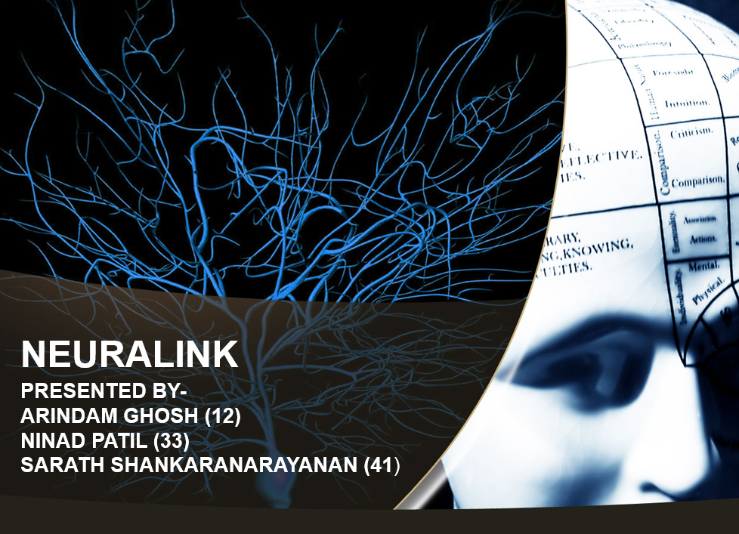

Slide 2
CONTENTS
What is Neuralink?
What does it do?
Science behind it.
How will it work?
Potential.
Video on Neuralink Chip tested on Animal.
Advantage of Neuralink.
Disadvantage of Neuralink.

Slide 3
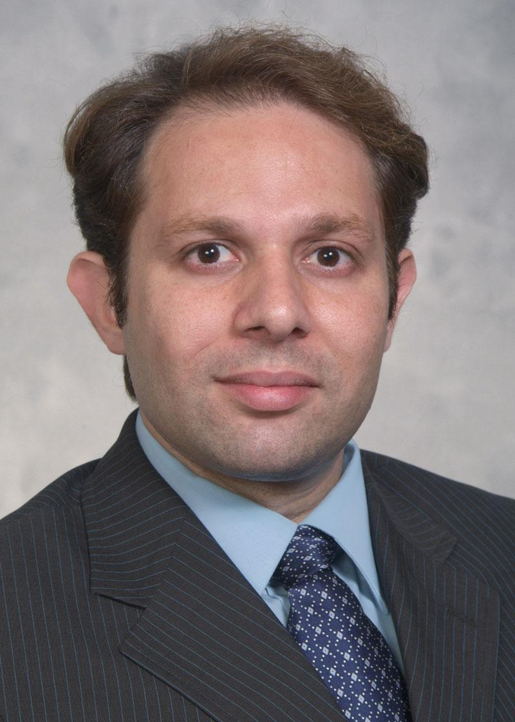
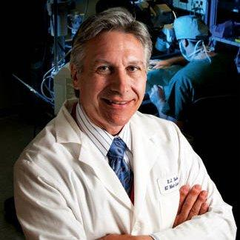
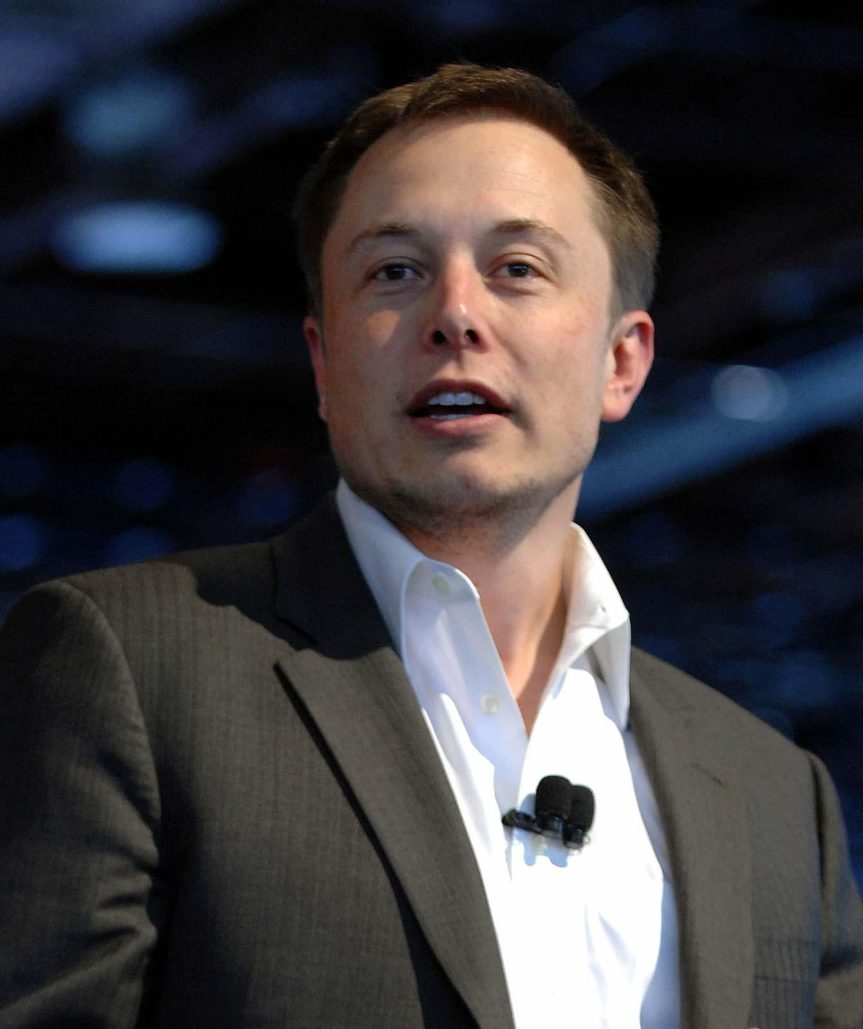
WHAT IS NEURALINK?
Pedram Mohseni & Randolph Nudo in 2015.
Bought by Elon Musk in 2016.
Jared Birchall (CEO).

Slide 4
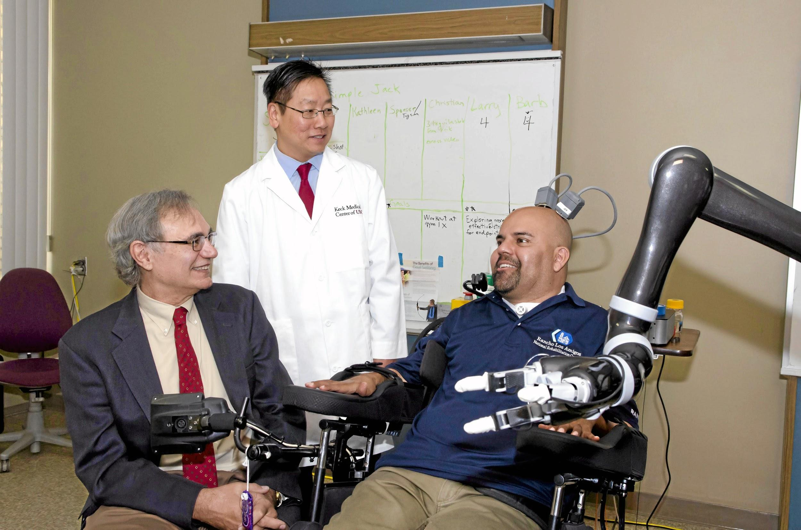
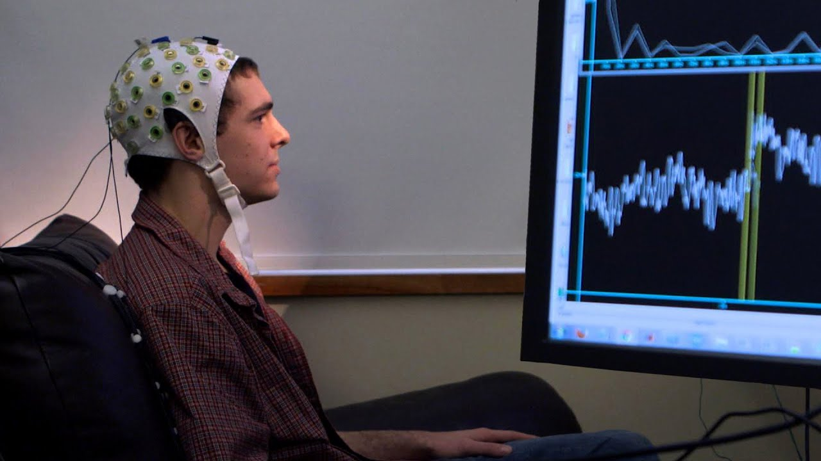
WHAT DOES IT DO
Brain-Computer Interface.
Neuroprosthetics (inside skull).
Fix multiple Brain Dysfunction.

Slide 5
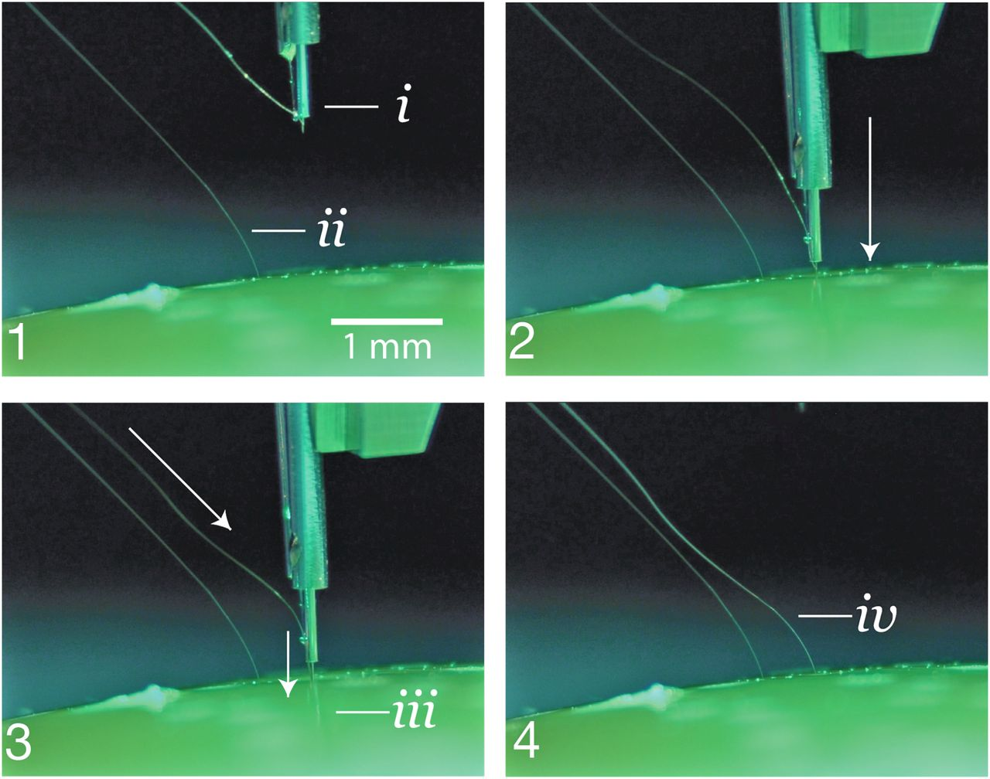
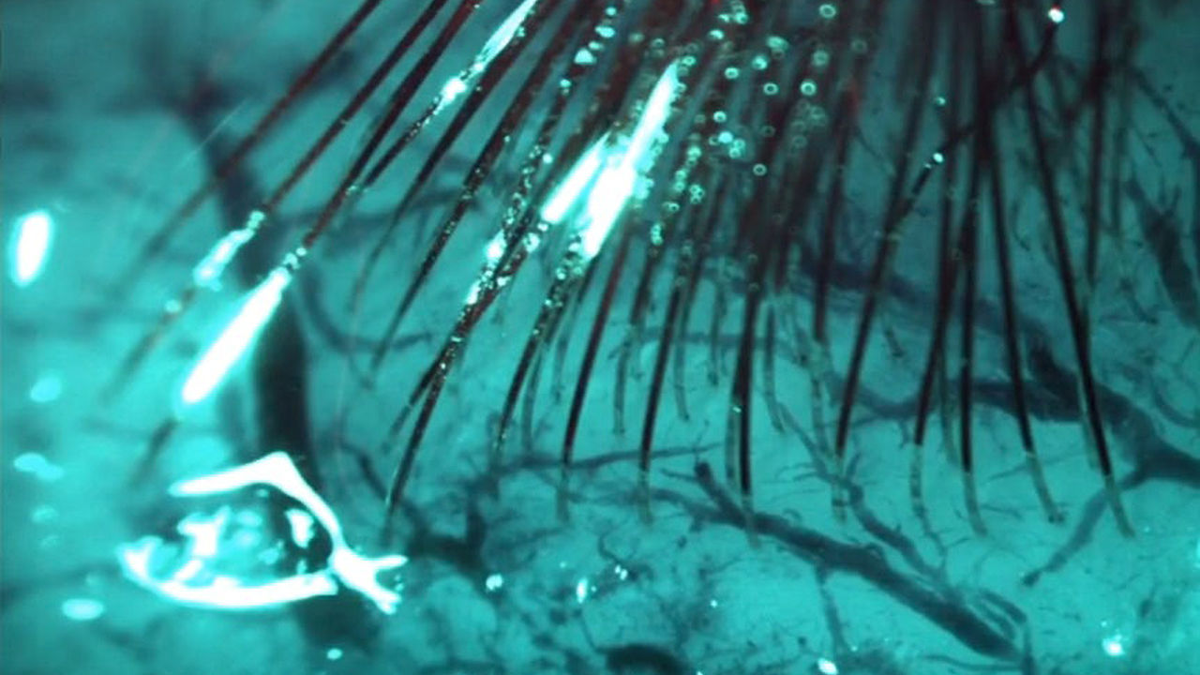
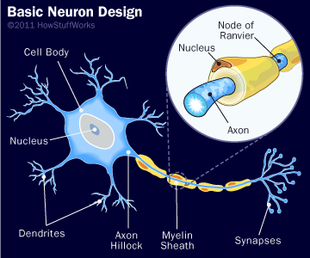
SCIENCE BEHIND IT
Brain is just Neuro Electrical Process.
Read Neuron directly using magnetic.
Alter impulse using Electricity.
Small electrode is used.

Slide 6
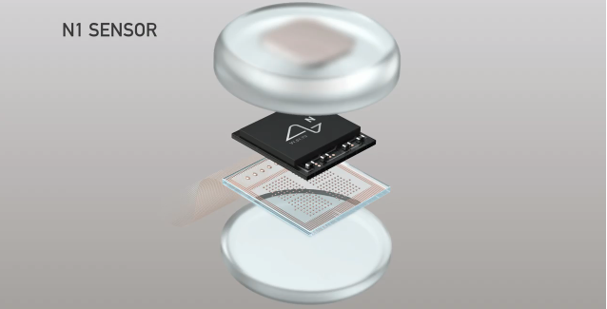
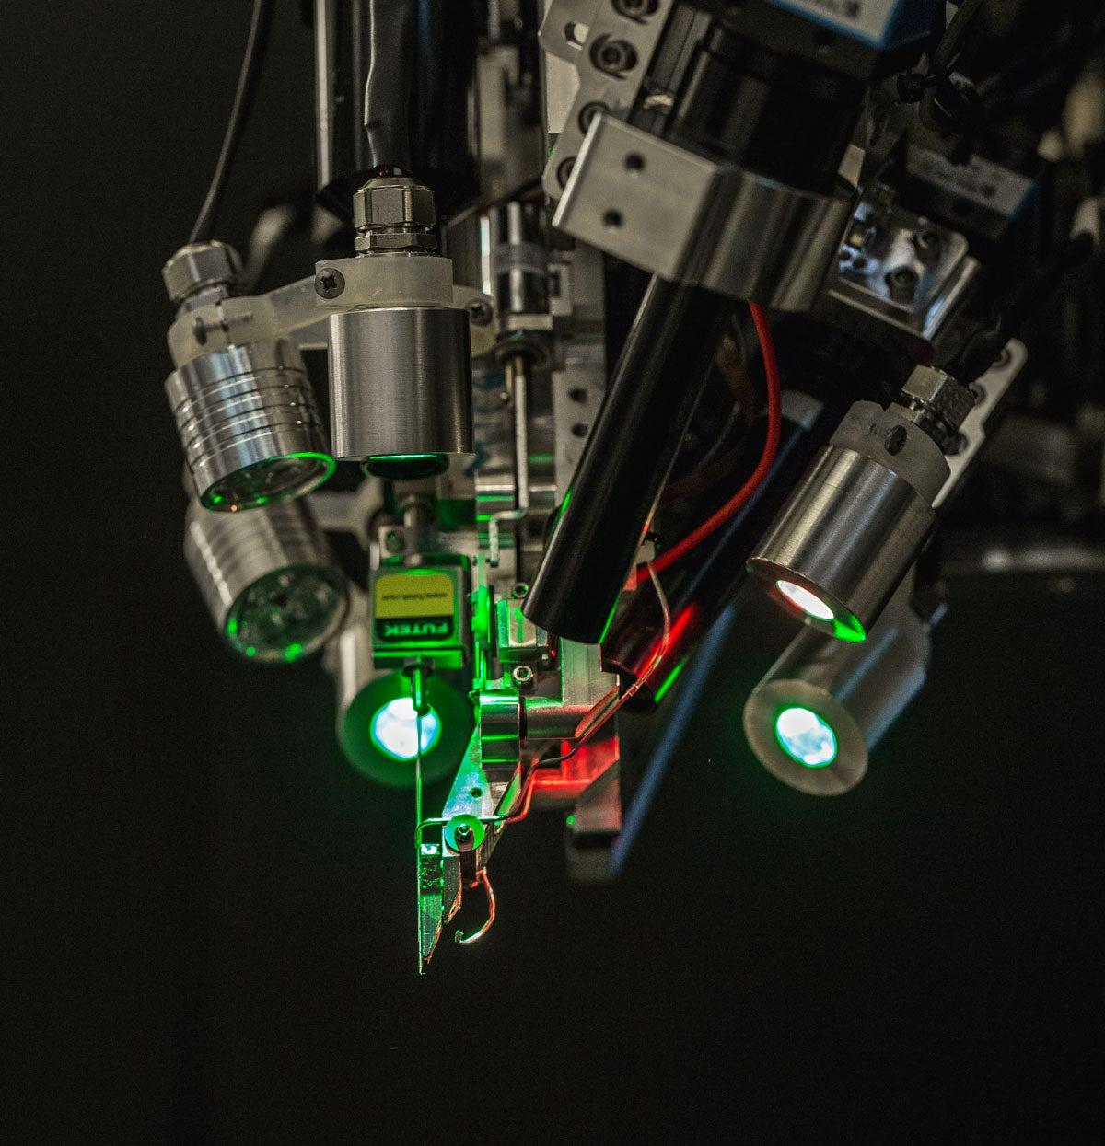
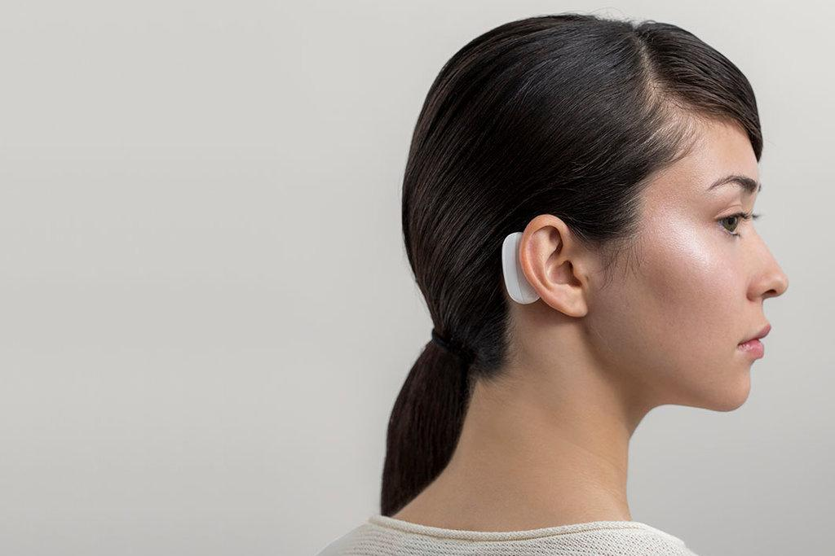
HOW WILL IT WORK
Thread implanting Robot.
Thread 2 Processor 2 pod.
Wireless power & Data.
Motion and Intent data.

Slide 7
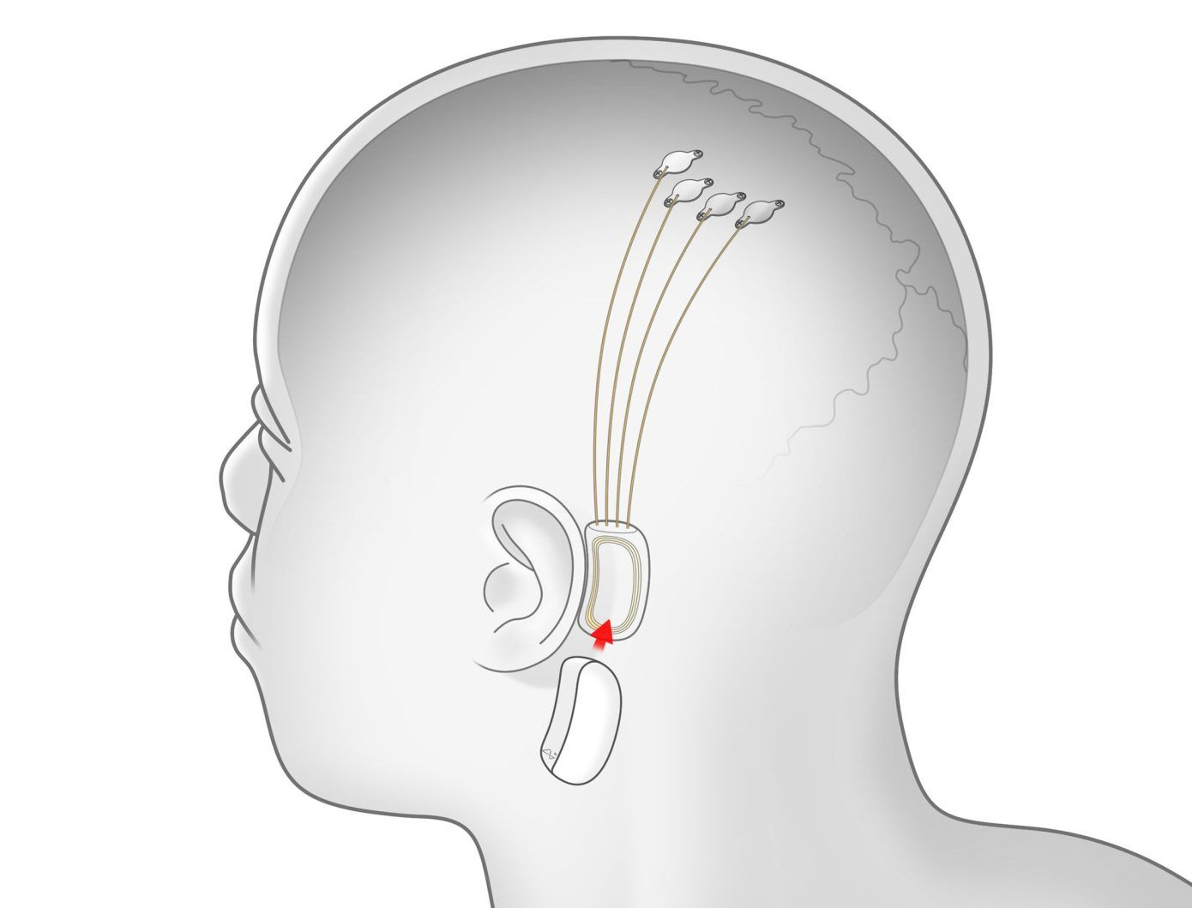
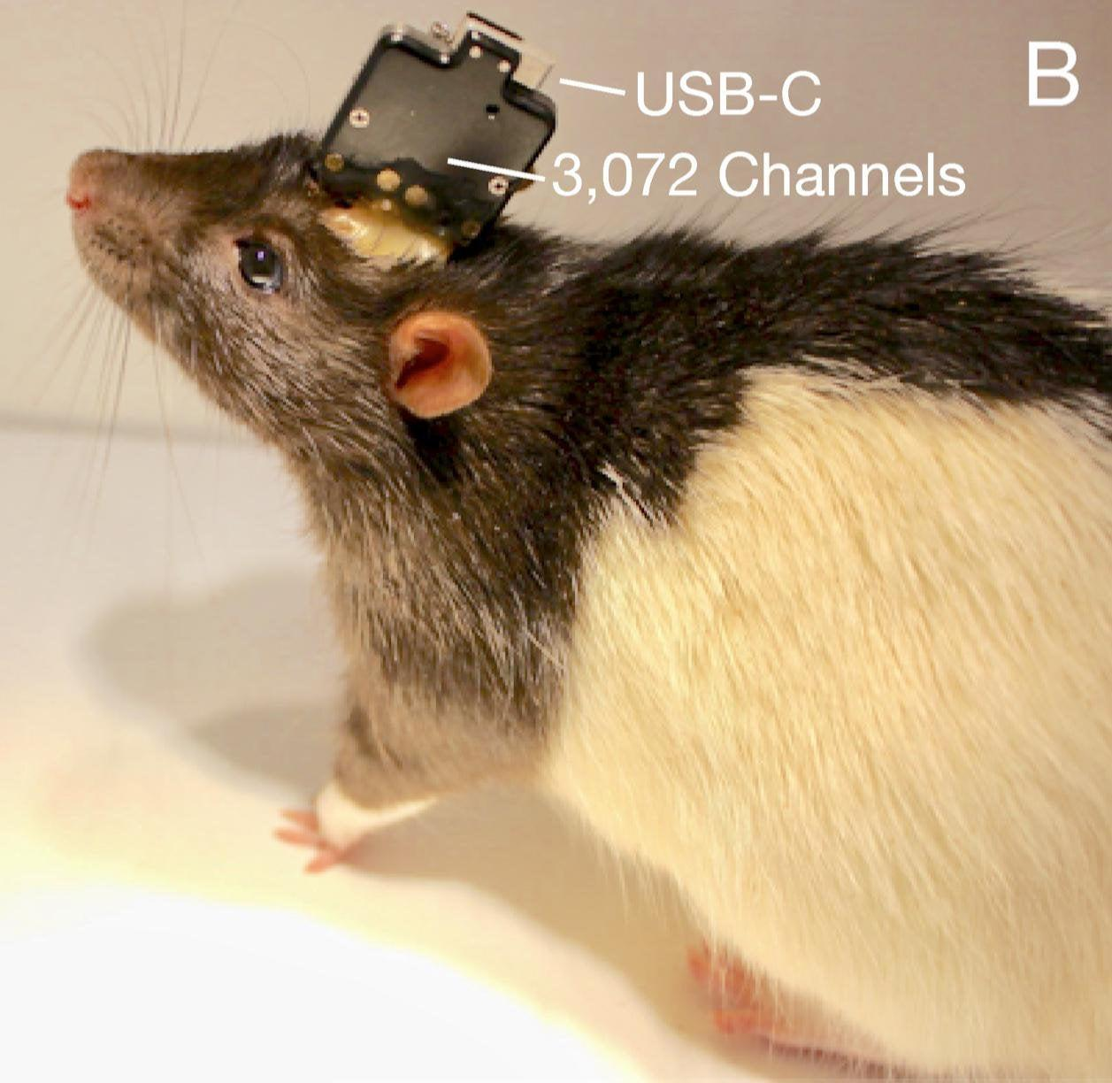
POTENTIAL
Biggest thing after Smartphone.
Human Testing targeting by 2021.
Animal testing is ongoing.

Slide 8

NEURALINK CHIP TESTED ON ANIMAL

Slide 9
ADVANTAGES OF NEURALINK
Ability to control a computer with your mind helping shut in people with severe paralysis communicate.
High precision mental control of machines.
A neural shunt allowing paralyzed people to regain control of their bodies.

Slide 10
DISADVANTAGES OF NEURALINK
Brain surgery though less risky than we might think if conducted with precision under sterile conditions.
Some unknown long term impact on the brain from decomposition by the body of the electrode materials over time.
They touched upon the need for regular upgrades, brain surgery every couple of years?

Slide 11
